Slide 1

Google Search

Slide 2





















Slide 3
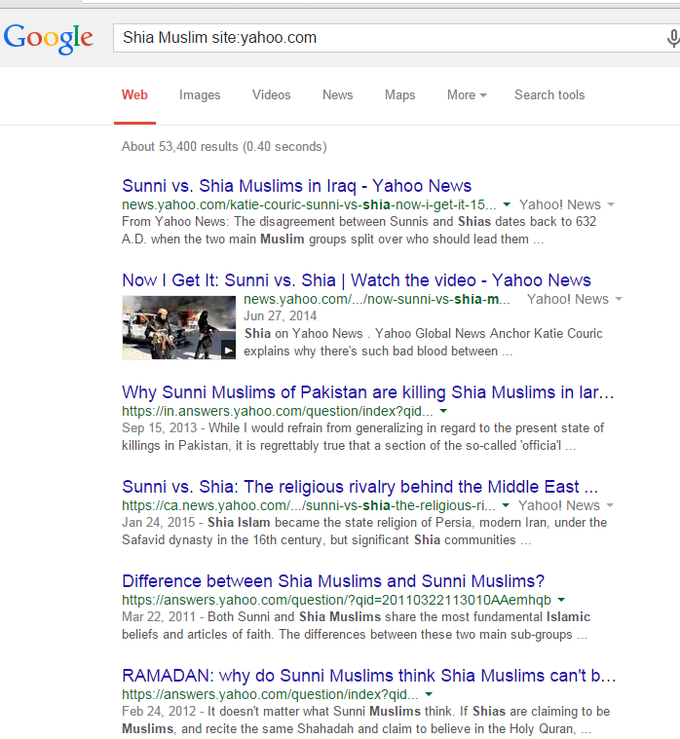
Google search operators
filetype:
Restrict search results by file type extension
Example -> marketing plan filetype:doc
doc ، docx ، ppt ، xls ، xlsx ، swf، pdf
برخی از پسوند های مجاز :
site:
Search within a site or domain
Example ->
مقاله site:masaf.ir
Example ->
Shia Muslim site:yahoo.com
Example ->
cryptography site:www.IEEE.org

Slide 4
Google search operators
inurl:
Search for a word or phrase within the URL
allinurl:
Example -> inurl:Cryptography
Example -> allinurl : CryptoGraphy DES
بدون فاصله
با فاصله
intext:
Search for a word in the main body text
allintext:
Example -> intext:Cryptography
Example -> allintext : CryptoGraphy DES
بدون فاصله
با فاصله

Slide 5
Google search operators
intitle:
Search for a word or phrase within the page title
allintitle:
Example -> intitle:Cryptography
Example -> allintitle : CryptoGraphy DES
بدون فاصله
با فاصله
inanchor:
Search for a word or phrase within anchor text
allinanchor:
Example -> inanchor:Cryptography
Example -> allinanchor : CryptoGraphy DES
بدون فاصله
با فاصله

Slide 6
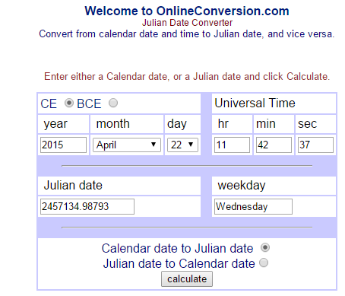
Google search operators
daterange:
Restrict search results to pages indexed during the
specified range (requires Julian dates)
Example -> marketing plan daterange:2454832-2455196
Example -> ایران خودرو daterange:2451597-2455250
Julian dates Converter

Slide 7
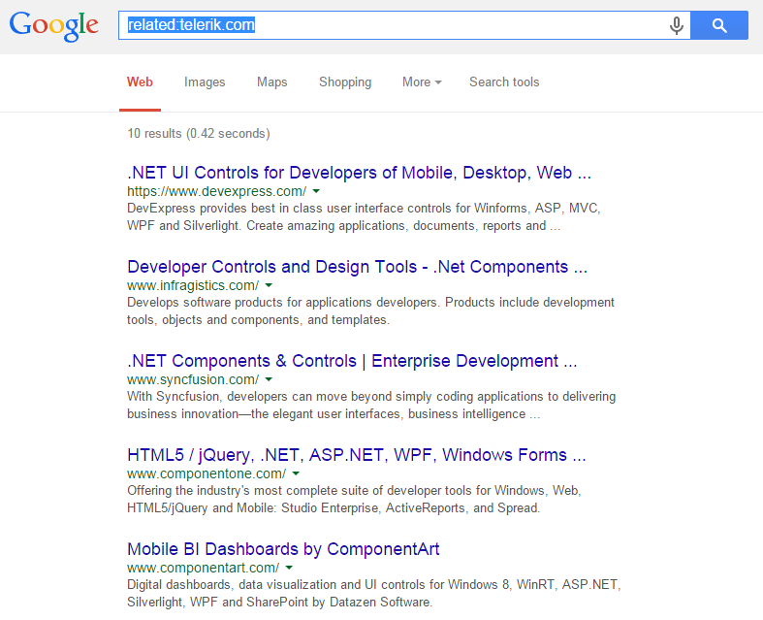
Google search operators
related:
Display pages of similar content
Example -> related: related:www.asp.net/web-forms/videos/aspnet-ajax
Example -> related:telerik.com

Slide 8
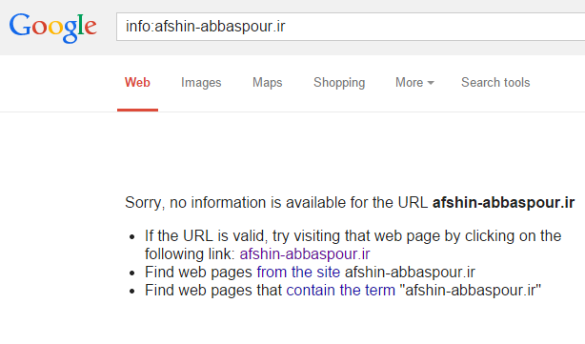
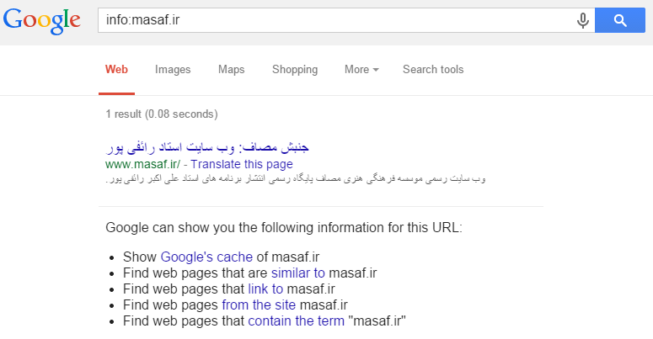
Google search operators
info:
Display info about a page that Google Know
Example -> info:masaf.ir

Slide 9
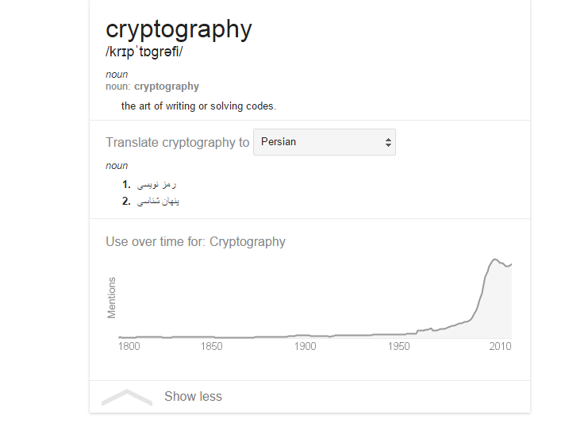
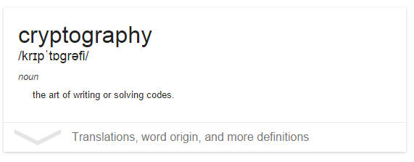
Google search operators
link:
Display pages that link to the specified page
Example -> link:masaf.ir
این امکان یکی از ابزارهای بررسی در SEO میباشد .
cache:
Display Google’s cached version of a page
Example -> cache:www.Masaf.ir
define:
Define a word or phrase
Example -> Define:Cryptography

Slide 10
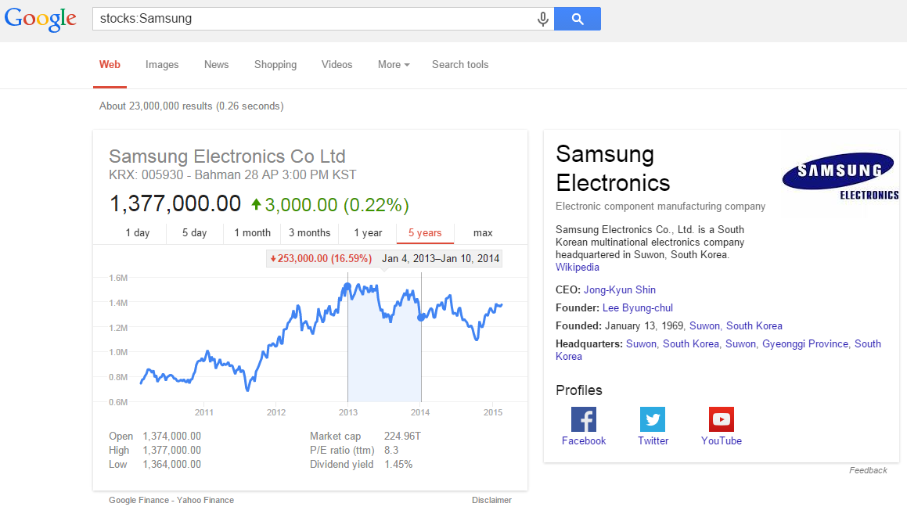
Google search operators
stocks:
Display stock quote and financial info for a specified
ticker symbol
Example -> stocks:Samsung
Stocks = سهام

Slide 11
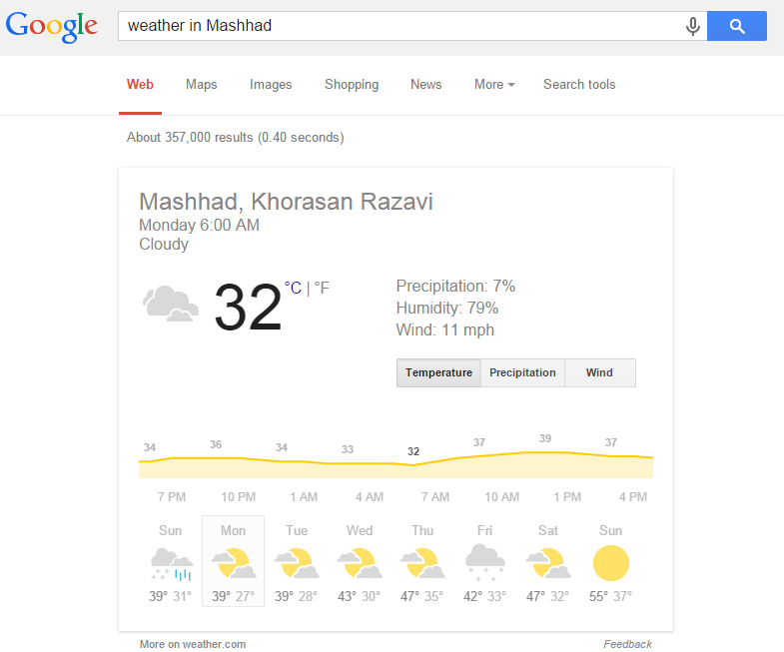
Google search operators
{weather in location} :
Shows a multiday basic weather forecast for the
specified location
Example -> weather in Iran
Example -> weather in Mashhad

Slide 12
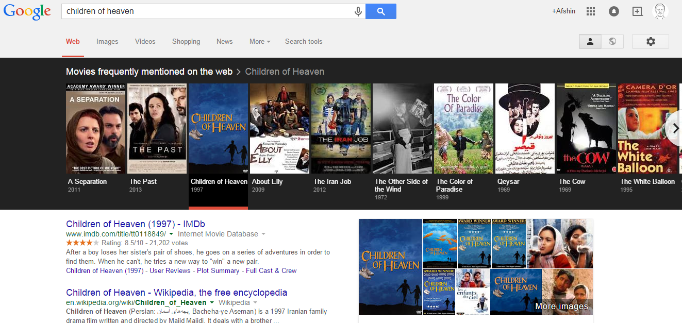
Google search operators
{movies in location} :
Returns movie showtimes that are playing at all
theaters in this location
Example -> movies in Iran

Slide 13
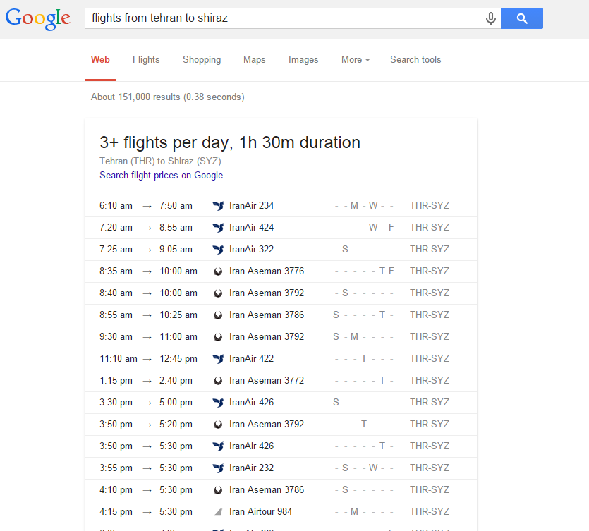
Google search operators
{flights to/from location} :
Returns flight times to, from, or between the
locations specified
Example -> flights from tehran to shiraz

Slide 14
Google

Slide 15
Google

Slide 16
Google-related services
Google Desktop | Program installed on your PC that indexes your documents, emails, and visited web pages. Search from your web browser.
Google Toolbar | Google search within the search results and related functionality integrated into your Internet Explorer or Firefox web browser
Google Pack | Free software for your Windows PC, including antivirus, antispyware, Google Desktop, and much more, all in one easy download
Google Alerts | Automated, free monitoring service of search results in Google and Google News for chosen keywords—a “clipping service” of sorts
Google Books | Google’s effort to digitize the world’s printed information
Soople | A third-party interface to the Google search engine.
Google Sets | Create a set of items from a few specified examples
Google Scholar | Search through scholarly literature
Google News | Search and browse news sources (both new and old, worldwide or within a particular country), by news source, relevance, or date

Slide 17
Google-related services
Google Groups | Browse, search, create, and post to discussion groups and Usenet newsgroups and to email discussion list
Google Images | Search for photos, clipart, logos, icons, and illustrations
Google Directory | A searchable directory of sites, editorially reviewed and organized by topic
Google Search by Country or Language | Search only those websites that are in a particular country . http://www.askapache.com
YouTube | http://www.youtube.com
Google+ (Google Plus) | https://plus.google.com
Google Product Search | http://www.google.com/prdhp
Blogger | http://www.blogger.com
Google Web History | https://history.google.com/history OR http://www.google.com/searchhistory.

Slide 18
Google-related services
Google Reader | http://reader.google.com
Google SMS | http://sms.google.com
Google Mobile | http://www.google.com/mobile
Google Talk | https://talk.google.com
Google Earth | http://earth.google.com
Picasa | http://picasa.google.com
Google Patent Search | http://www.google.com/patents
Google Trends | http://www.google.com/trends
Google Calendar | http://www.google.com/calendar

Slide 19
Google-related services
Google Code Search | http://www.google.com/codesearch
Google Mobile App for Smartphones | http://m.google.com Or http://www.google.com/mobile

Slide 20
Google

Slide 21
Google

Slide 22
Google

